Slide 1
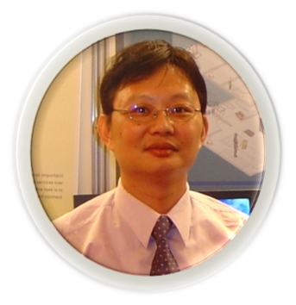
Python程式與資訊安全
Python-CTF: Python實戰CTF
使用Python求解CTF實戰課

Slide 2
一日上手快速入門
深耕營
早上 | Python程式設計 | MTA Python證照小考
下午 | 使用Python解編碼問題 | Python-CTF實戰 編碼與解碼102
 | 使用Python解破密問題 | Crypto 102
 | 使用python加解密 RSA + Hashing
 | 使用Python解WEB問題
研習營 | NEXT
 | Python與PPC | 趙偉傑
 | 現代密碼之破密分析RSA
研習營 | NEXT NEXT
 | 進階現代密碼之破密分析

Slide 3
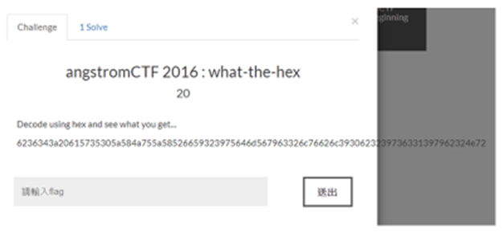

Slide 4
angstromCTF 2016 : what-the-hex 20
解題步驟1:
echo "6236343a20615735305a584a755a58526659323975646d567963326c76626c3930623239736331397962324e72" | xxd -r -p
解題步驟2:
echo aW50ZXJuZXRfY29udmVyc2lvbl90b29sc19yb2Nr | base64 -d

Slide 5
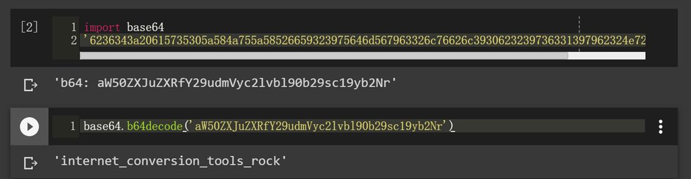
Python 2
import base64
'6236343a20615735305a584a755a58526659323975646d567963326c76626c3930623239736331397962324e72'.decode("hex")
base64.b64decode('aW50ZXJuZXRfY29udmVyc2lvbl90b29sc19yb2Nr')

Slide 7
c = '87 101 108 1100011 0157 6d 0145 040 116 0157 100000 0164 104 1100101 32 0123 69 67 0103 1001111 \
1001110 040 062 060 49 064 100000 0157 110 6c 0151 1101110 101 040 0103 1010100 70 101110 0124 \
1101000 101 100000 1010011 1000101 67 0103 4f 4e 100000 105 1110011 040 116 1101000 0145 040 \
1100010 0151 103 103 0145 1110011 0164 100000 1101000 0141 99 6b 1100101 0162 32 0143 111 1101110\
1110100 101 0163 0164 040 0151 0156 040 74 0141 1110000 1100001 0156 056 4f 0157 0160 115 44 040\
0171 1101111 117 100000 1110111 0141 0156 1110100 32 0164 6f 32 6b 1101110 1101111 1110111 100000\
0164 1101000 0145 040 0146 6c 97 1100111 2c 100000 0144 111 110 100111 116 100000 1111001 6f 117\
63 0110 1100101 0162 0145 100000 1111001 111 117 100000 97 114 0145 46 1010011 0105 0103 67 79\
1001110 123 87 110011 110001 67 110000 1001101 32 55 060 100000 110111 0110 110011 32 53 51 0103\
0103 060 0116 040 5a 0117 73 0101 7d 1001000 0141 1110110 1100101 100000 102 0165 0156 33'
87
101
6d
0157

Slide 8
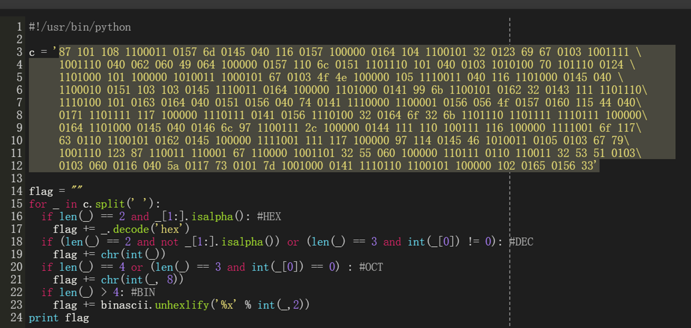
Python 2
https://github.com/S42X/CTF/blob/master/SECCON/EasyCipher.md
binascii

Slide 9

SECCON CTF 2014: Easy Cipher 100 https://github.com/S42X/CTF/blob/master/SECCON/EasyCipher.md
#!/usr/bin/python
c = ‘………………'
flag = ""
for _ in c.split(' '):
if len(_) == 2 and _[1:].isalpha(): #HEX f
lag += _.decode('hex')
if (len(_) == 2 and not _[1:].isalpha()) or (len(_) == 3 and int(_[0]) != 0): #DEC
flag += chr(int(_))
if len(_) == 4 or (len(_) == 3 and int(_[0]) == 0) : #OCT
flag += chr(int(_, 8))
if len(_) > 4: #BIN
flag += binascii.unhexlify('%x' % int(_,2))
print flag

Slide 10
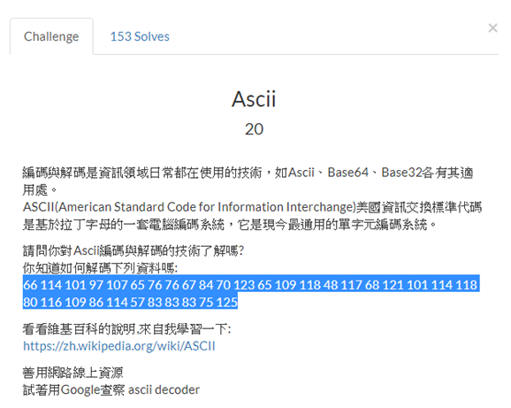
再用Python解此題

Slide 11
#!/usr/bin/python
c = '66 114 101 97 107 65 76 76 67 84 70 123 65 109 118 48 117 68 121 101 114 118 80 116 109 86 114 57 83 83 83 75 125'
flag = ""
for _ in c.split(' '):
flag += chr(int(_))
print flag

Slide 12
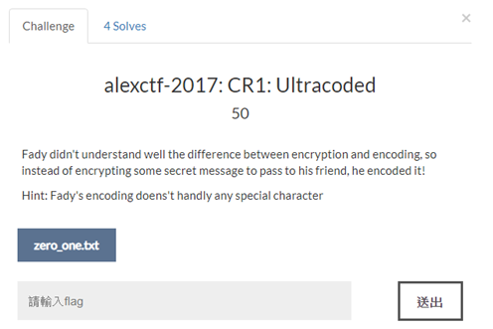

Slide 13
摩斯謨斯大變身

Slide 14
alexctf-2017: CR1: Ultracoded 50 https://fadec0d3.blogspot.tw/2017/02/alexctf-2017-crypto.html https://0xd13a.github.io/ctfs/alexctf2017/ultracoded/
from pwn import *
import morse_talk as mtalk
with open('zero_one', 'r') as f:
data = f.read().translate(None, ' \n')
data =data.replace("ZERO","0").replace("ONE","1")
data = b64d(''.join(chr(int(data[i:i+8], 2))
for i in xrange(0, len(data), 8)))
data = mtalk.decode(data)
print data

Slide 15
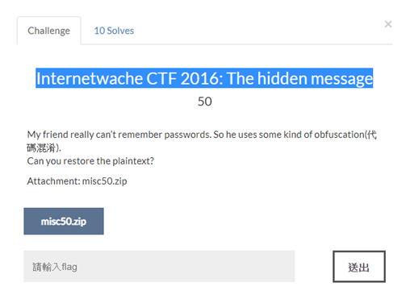

Slide 16
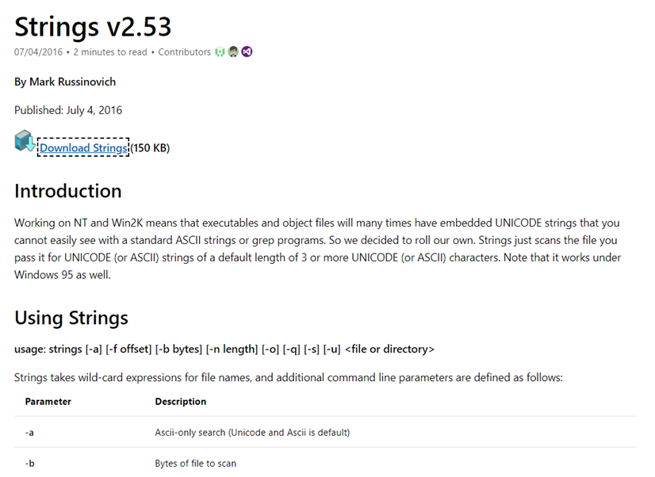

Slide 17
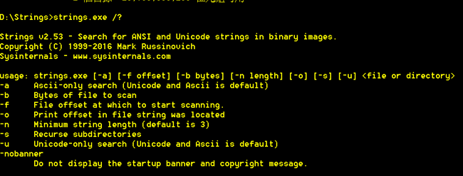

Slide 18
解題步驟1:
file fore1.core
解題步驟2:
strings fore1.core
…. cvqAeqacLtqazEigwiXobxrCrtuiTzahfFreqc{bnjrKwgk83kgd43j85ePgb_e_rwqr7fvbmHjklo3tews_hmkogooyf0vbnk0ii87Drfgh_n kiwutfb0ghk9ro987k5tfb_hjiouo087ptfcv}
….

Slide 19
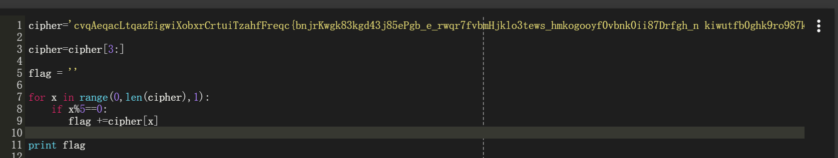

Slide 20
解題步驟3:使用python解題
cipher='cvqAeqacLtqazEigwiXobxrCrtuiTzahfFreqc{bnjrKwgk83kgd43j85ePgb_e_rwqr7fvbmHjklo3tews_hmkogooyf0vbnk0ii87Drfgh_n kiwutfb0ghk9ro987k5tfb_hjiouo087ptfcv}‘
cipher=cipher[3:]
flag = ''
for x in range(0,len(cipher),1):
if x%5==0:
flag+=cipher[x]
print flag

Slide 21
第二種解法
s = 'cvqAeqacLtqazEigwiXobxrCrtuiTzahfFreqc{bnjrKwgk83kgd43j85ePgb_e_rwqr7fvbmHjklo3tews_hmkogooyf0vbnk0ii87Drfgh_n kiwutfb0ghk9ro987k5tfb_hjiouo087ptfcv}'
print s[3::5]

Slide 22
第三種解法
cipher='cvqAeqacLtqazEigwiXobxrCrtuiTzahfFreqc{bnjrKwgk83kgd43j85ePgb_e_rwqr7fvbmHjklo3tews_hmkogooyf0vbnk0ii87Drfgh_n kiwutfb0ghk9ro987k5tfb_hjiouo087ptfcv}'
''.join(cipher[3 : : 5])

Slide 23
qiwi_infosec_ctf_2016/crypto_100_3

Slide 24
DNA編碼學
qiwi_infosec_ctf_2016_crypto_100 100
https://github.com/USCGA/writeups/tree/master/online_ctfs/qiwi_infosec_ctf_2016/crypto_100_3_COMPLETE

Slide 25
qiwi_infosec_ctf_2016_crypto_100 100 https://github.com/USCGA/writeups/tree/master/online_ctfs/qiwi_infosec_ctf_2016/crypto_100_3_COMPLETE
mapping = { 'CGA': 'A', 'CCA': 'B', 'GTT': 'C', 'TTG': 'D', 'GGC': 'E', 'GGT': 'F', 'TTT': 'G', 'CGC': 'H', 'ATG': 'I', 'AGT': 'J', 'AAG': 'K', 'TGC': 'L', 'TCC': 'M', 'TCT': 'N', 'GGA': 'O', 'GTG': 'P', 'AAC': 'Q', 'TCA': 'R', 'ACG': 'S', 'TTC': 'T', 'CTG': 'U', 'CCT': 'V', 'CCG': 'W', 'CTA': 'X', 'AAA': 'Y', 'CTT': 'Z', 'ATA': ' ', 'TCG': ',', 'GAT': '.', 'GCT': ':', 'ACT': '0', 'ACC': '1', 'TAG': '2', 'GCA': '3', 'GAG': '4', 'AGA': '5', 'TTA': '6', 'ACA': '7', 'AGG': '8', 'GCG': '9' }

Slide 26
def decode_dna( string ):
pieces = []
for i in range( 0, len(string), 3 ):
piece = string[i:i+3]
# pieces.append()
pieces.append( mapping[piece] )
return "".join(pieces)
string = 'GGTTCAATGGGCTTGTCAATGGTTCGCATATCCATGGGCACGGTTCGCGGCTCA'
print decode_dna(string)

Slide 28
Crypto_103_affine-cipher
School CTF 2015: affine-cipher-100(教) 150 https://github.com/BurningMarshmallow/CTF/blob/master/affine_solve.py
import string
s = string.ascii_lowercase # a-z
s += '_'
d = {}
for c in range(len(s)):
d[s[(c*4 + 15)%27]] = s[c]
ciphertext = 'ifpmluglesecdlqp_rclfrseljpkq'
s1 = ''
for x in ciphertext :
s1 += d[x]
print s1

